Slide 1
EE481–Digital Image Processing
10B-Image Segmentation

Slide 2
Image Segmentation (Recall)
Segmentation algorithms are based on one of two basic properties of gray-scale values:
  Discontinuity
    Partition an image based on abrupt changes in gray-scale levels.
    Detection of isolated points, lines, and edges in an image.
  Similarity
    Thresholding, region growing, and region splitting/merging.
Image Segmentation

Slide 3
Overview
Point Detection
Line Detection
Edge Detection
Image Segmentation

Slide 4
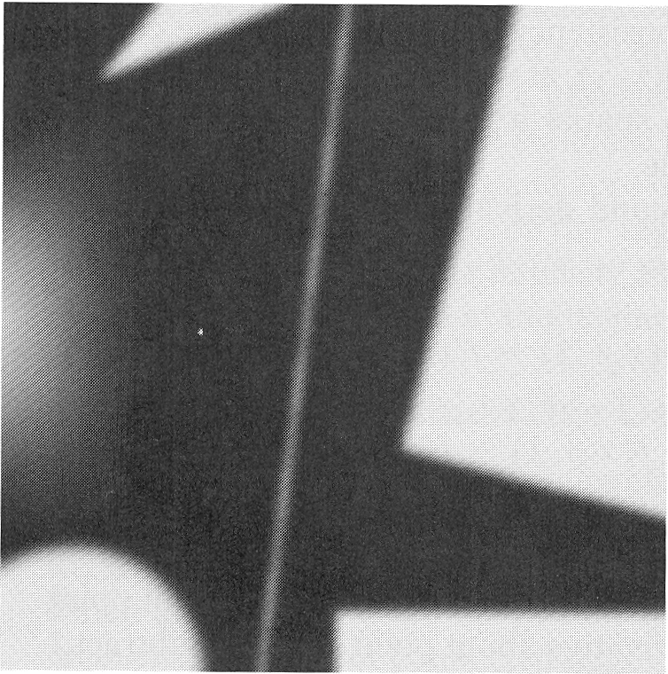
Recall – Chapter 3
Example
  This image contains various objects a line and an isolated noise point
  We consider a horizontal line passing through the isolated point
Image Segmentation

Slide 5
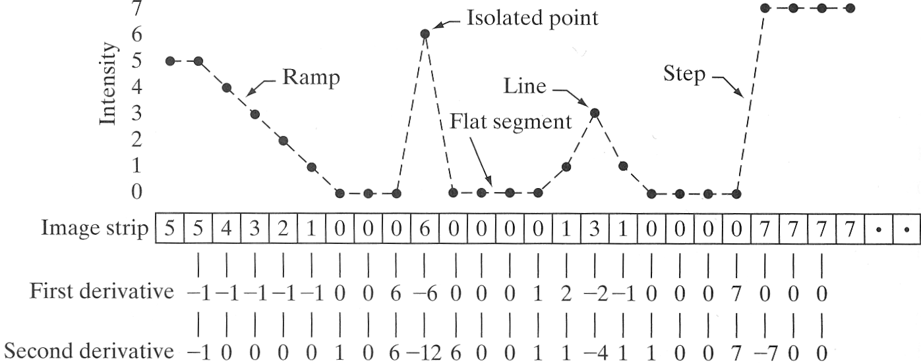
Recall – Chapter 3
We consider the properties of the first and the second order differences of the intensity as we traverse the line from left to right.
Image Segmentation

Slide 6
Recall – Key Points
First order differences generally produce thicker edges in an image (see the ramp).
Second order differences have a stronger response to fine detail, such as isolated points and thin lines (see isolated point and the line).
The second order difference produces a double response as it transitions into and out of an edge (see ramp and step).
The sign of the second order difference can determine if the transition is from light to dark, or vice-versa (see ramp and step).
Image Segmentation

Slide 7
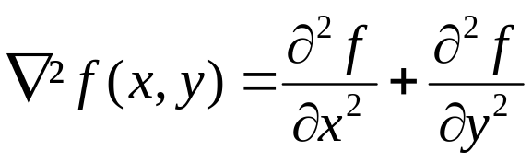
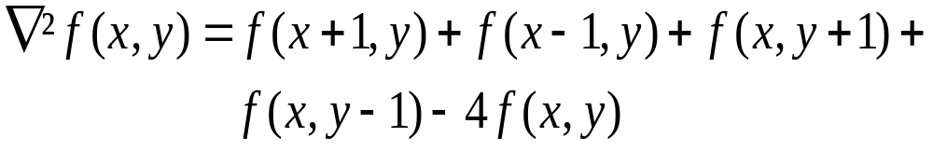
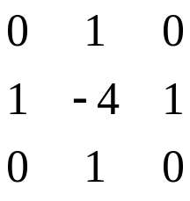
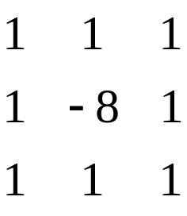
Detection of Isolated Points
Isolated Point
  Gray level – Different from neighboring pixels
Second Derivative – Laplacian (Recall)
Implementation – Spatial filters
Image Segmentation

Slide 8
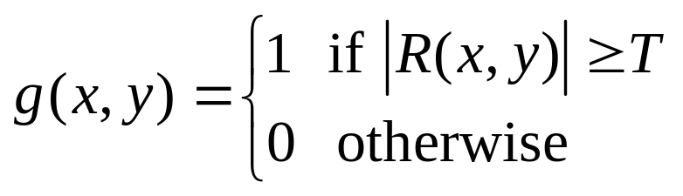
Detection of Isolated Points
We say that a point has been detected at the location (x,y), if the absolute value of the response is above a threshold T
If the detected points are labelled 1 and all others are labelled 0, we can visualise the results of point detection by a binary image g(x,y)
Image Segmentation

Slide 9
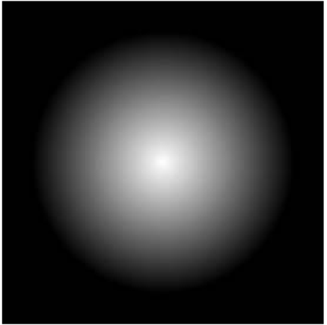

Detection of Isolated Points
Example
Original image with a nearly invisible isolated dark point in the dark gray area
Binary image showing the detected point
Image Segmentation

Slide 10
Line Detection
A line is an edge segment in which the intensity of the background on either side is either much higher or much lower than the intensity of the line pixels
Assumption: Lines are thin w.r.t. size of detector
Laplacian Mask – Line Detection
Image Segmentation

Slide 11
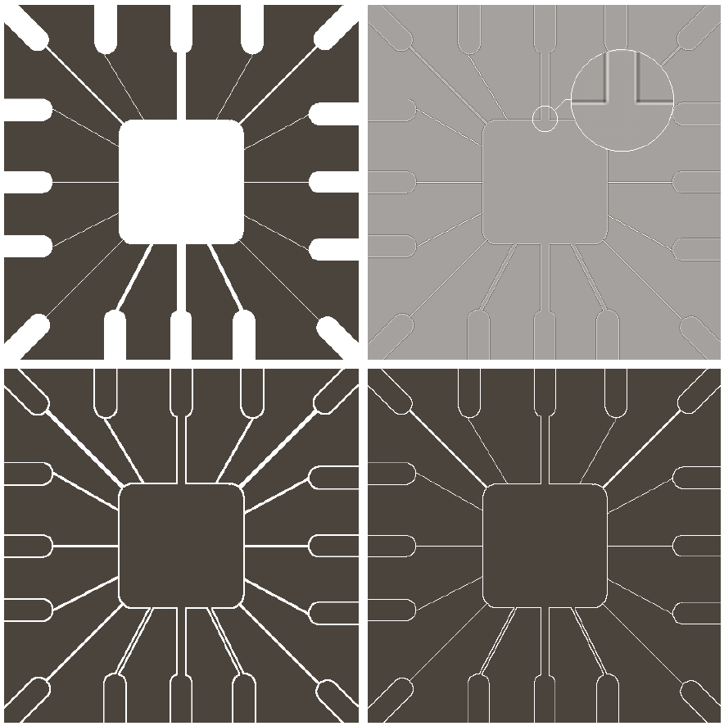
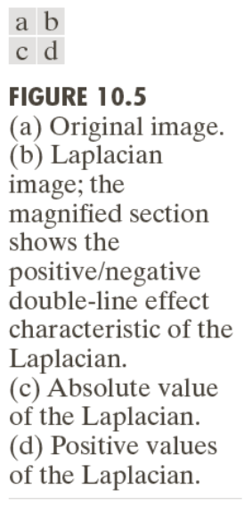
Line Detection
Image Segmentation

Slide 12
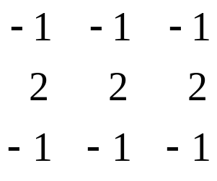
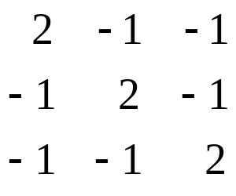
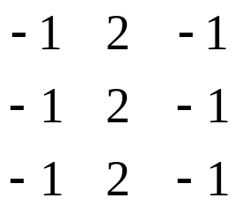
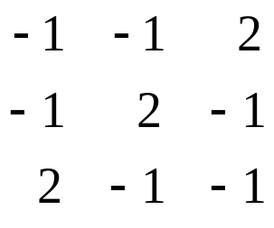
Line Detection
Anisotropic masks
The previous mask is isotropic – Does not have preference for any particular direction
Anisotropic masks can be used to detect lines in specified directions
Horizontal
-45°
Vertical
+ 45°
Image Segmentation

Slide 13
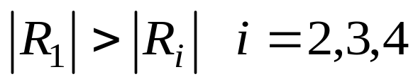
Line Detection
Let R1, R2, R3, R4 be the responses of the previous four masks centred on (x,y)
The pixel (x,y) is said to be more likely associated with the direction of the mask with the highest response in absolute values
For example, if
we say that (x,y) is more likely associated with the horizontal direction
Image Segmentation

Slide 14



Line Detection
To detect lines in a specified direction, we run the corresponding mask through the image and threshold the absolute values of the result
Example
Original image
Response of the -45° line detection mask
Image Segmentation

Slide 15
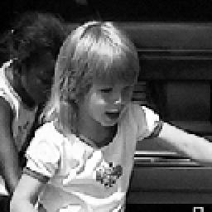



Edge Detection
Edge – Area of significant change in intensity
Edge Detection – Locating areas with strong intensity contrast
Local changes of intensity can be detected using differences of neighbouring pixels
Image Segmentation

Slide 16

Types of Edges
Variation of intensity/gray level
  Step Edge
  Ramp Edge
  Roof Edge
Step Edge
Ramp Edge
Roof Edge
Image Segmentation

Slide 17
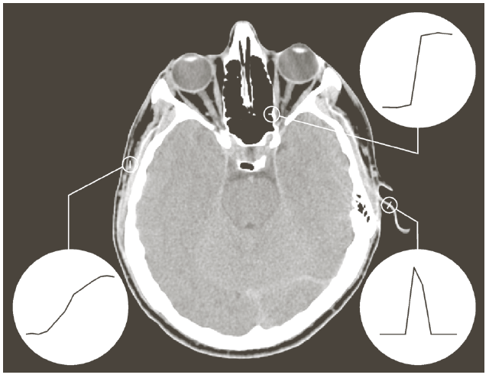
Types of Edges
Example
  Deviations from ideal models
Step
Roof
Ramp
Image Segmentation

Slide 18
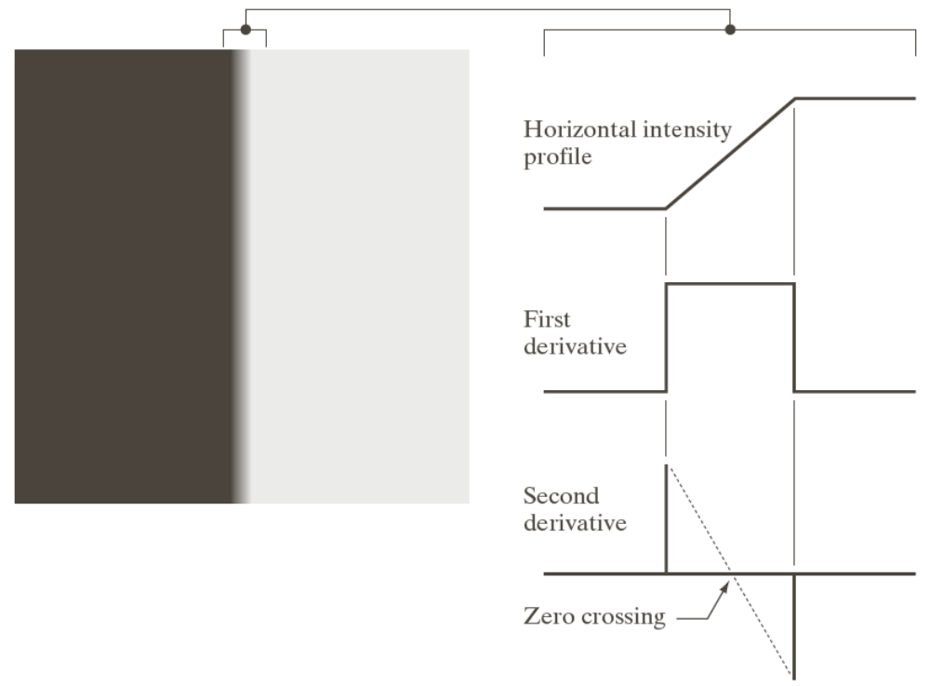
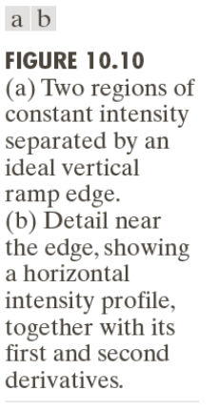
Types of Edges
Example
Image Segmentation

Slide 19
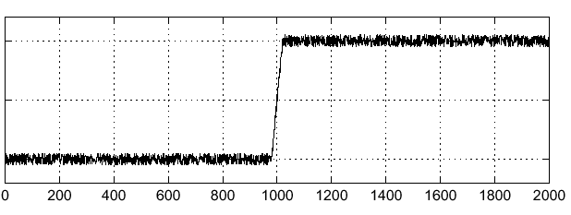

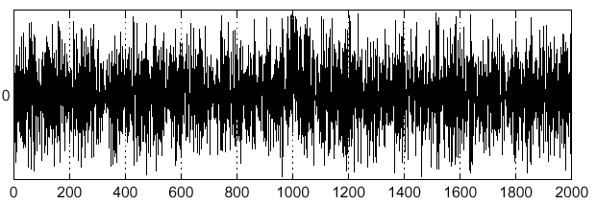
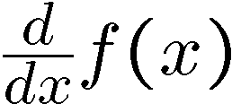
Edge Detection – Effects of Noise
Consider a single row or column of the image
  Plotting intensity as a function of position gives a signal
Where is the edge??
Image Segmentation

Slide 20
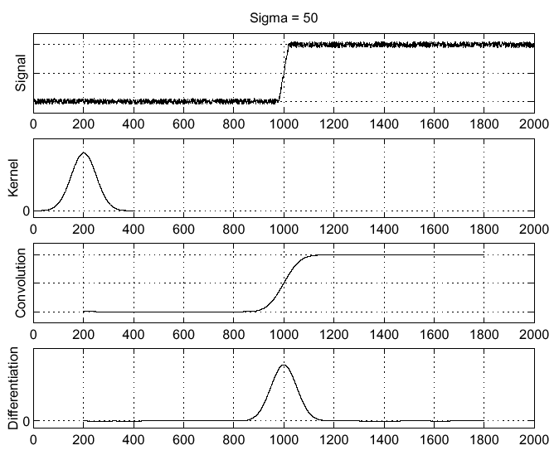



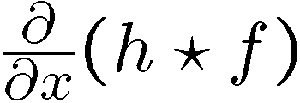
Effects of Noise - Solution
Smoothing
Image Segmentation

Slide 21
Edge Detection
Key Steps
  Image Smoothing – Noise Reduction
  Detection of Edge Points
  Edge Localization
Image Segmentation

Slide 22
Detecting Edge Points
First Derivative / Gradient Methods
  Roberts Operator
  Prewitt Operator
  Sobel Operator
Second Derivative
  Laplacian
  Laplacian of Gaussian
Optimal Edge Detection
  Canny Edge Detector
Image Segmentation

Slide 23
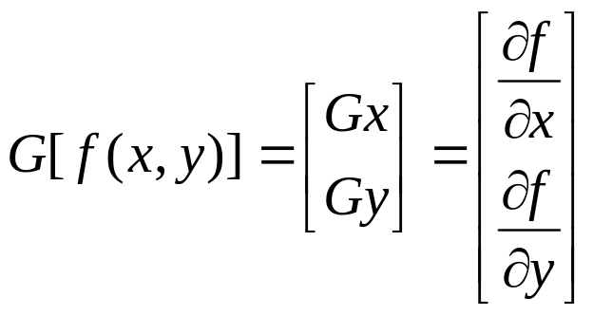
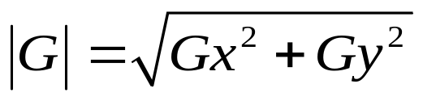
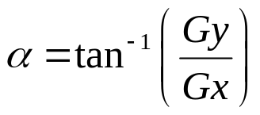
Gradient
For a continuous two dimensional function Gradient is defined as
Image Segmentation

Slide 24
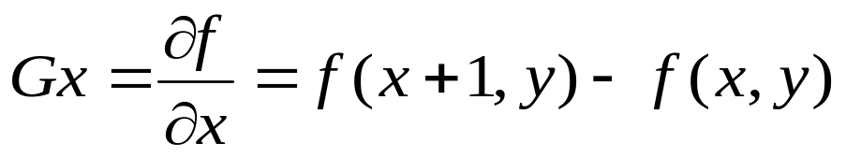
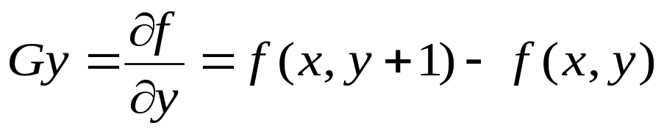
Gradient
Approximation of Gradient for a discrete two dimensional function
Gradient Magnitude: ‘Strength’ of edge
Gradient Direction: Points in the direction of most rapid change in intensity
Image Segmentation

Slide 25
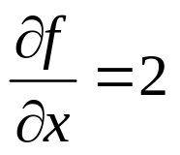
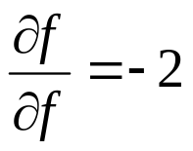
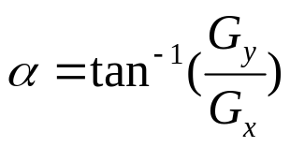
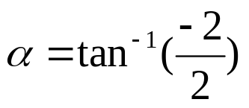
Gradient
x
0 | 1 | 1 | 1 | 1 | 1
0 | 0 | 1 | 1 | 1 | 1
0 | 0 | 0 | 1 | 1 | 1
0 | 0 | 0 | 0 | 1 | 1
0 | 0 | 0 | 0 | 0 | 1
0 | 0 | 0 | 0 | 0 | 0
y

Slide 26
Gradient
Implementation: Convolution Masks
-1
1
-1 | 1
Diagonal Direction: Roberts cross-gradient operators
0 | -1
1 | 0
-1 | 0
0 | 1
2x2 Masks: Differences are computed at interpolated points
3x3 Masks: Symmetric about the central pixel
Image Segmentation

Slide 27
Gradient
Prewitt Operators
-1 | -1 | -1
0 | 0 | 0
1 | 1 | 1
-1 | 0 | 1
-1 | 0 | 1
-1 | 0 | 1
Sobel Operators
-1 | -2 | -1
0 | 0 | 0
1 | 2 | 1
-1 | 0 | 1
-2 | 0 | 2
-1 | 0 | 1
Image Segmentation

Slide 28
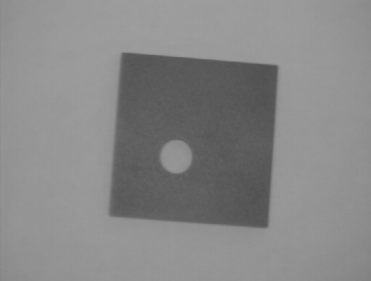
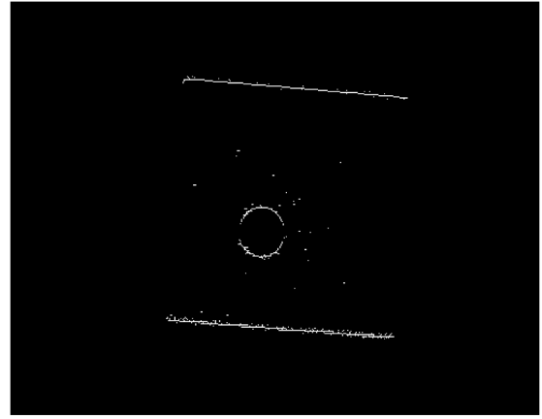
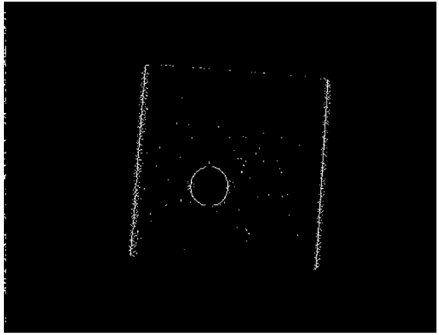
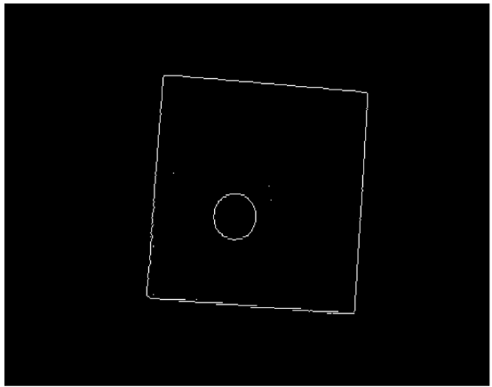

Edge Detection
Example
Original Image
Horizontal Edges
Vertical Edges
Horizontal + Vertical
Image Segmentation

Slide 29
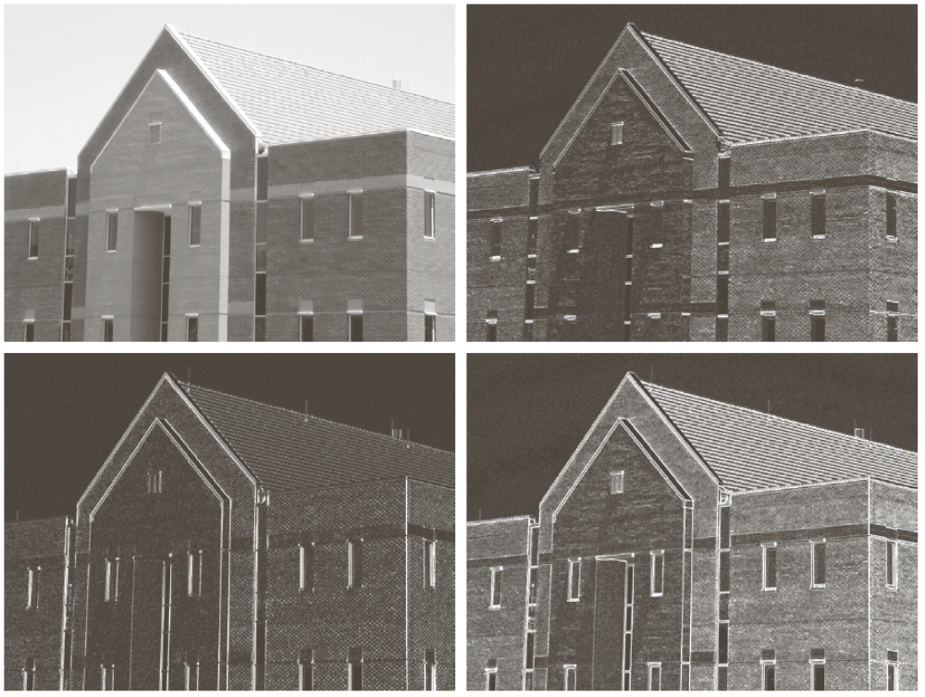
Edge Detection
Example
Original Image
Horizontal Edges
Vertical Edges
Gradient Magnitude
Image Segmentation

Slide 30
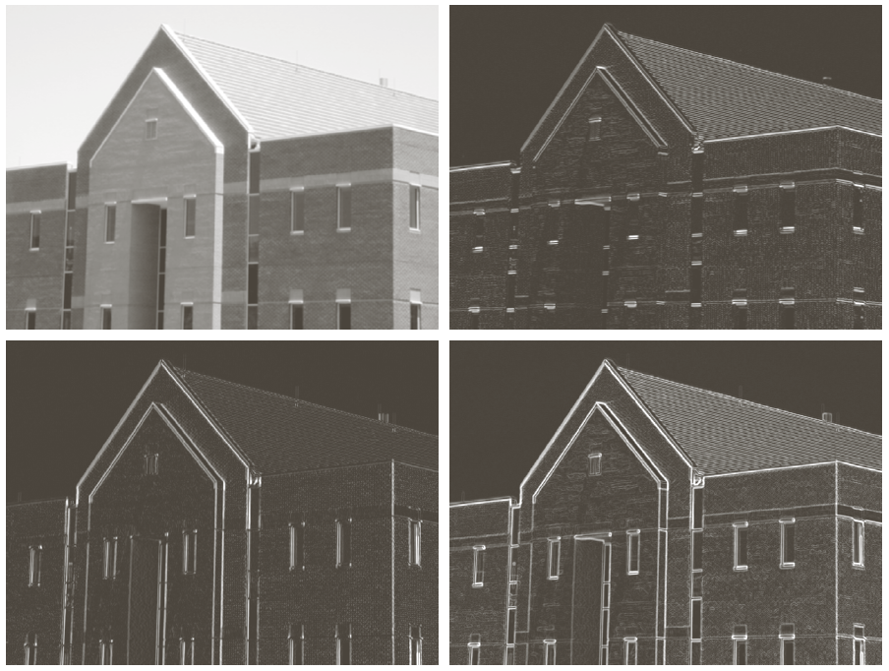
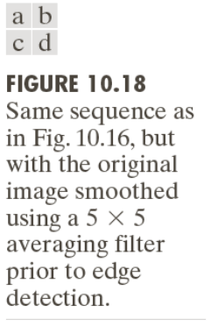
Edge Detection with Smoothing
Example
Image Segmentation

Slide 31
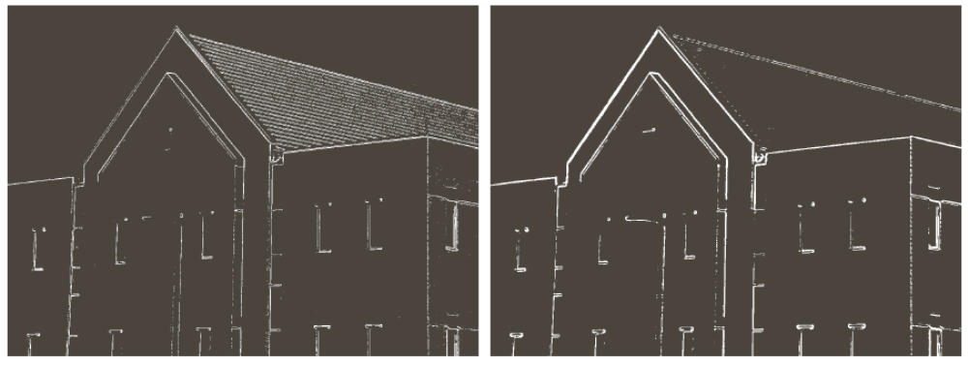
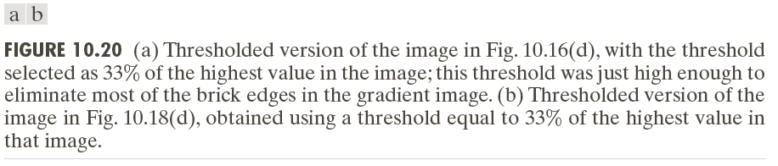
Edge Detection with Thresholding
Example
Image Segmentation

Slide 32
References
Chapter # 10, DIP by Gonzalez & Woods
Lecture slides by:
  Cornelia Fermüller
  Sumit Tandon
  Ioannis Ivrissimtzis
  Longin Jan Latecki
http://homepages.inf.ed.ac.uk/rbf/HIPR2/
Image Segmentation

